Slide 1
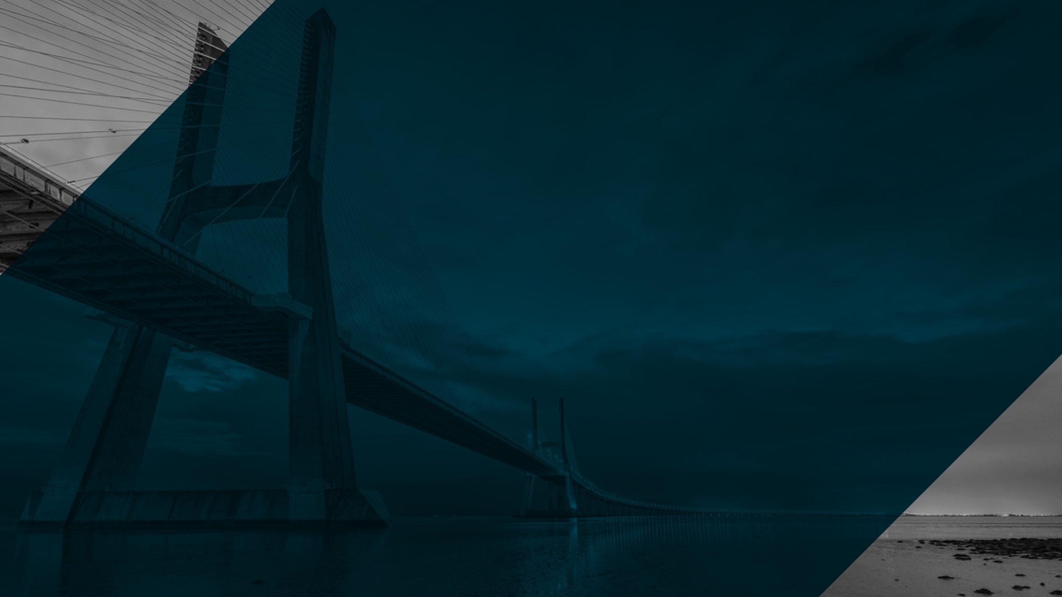

Introduction to OpenShift

Slide 2



Digital Transformation
Requires an Evolution in...
APPLICATIONS
New ways of developing, delivering and integrating applications
PROCESS
More agile processes across both IT and the business
INFRASTRUCTURE
Modernize existing and build new cloud based infrastructure
2

Slide 3
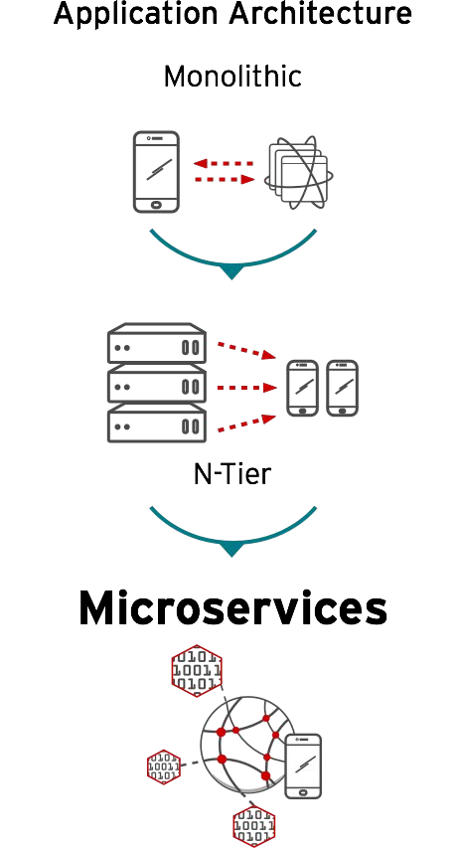
Application Architecture
Shift from monolithic applications to microservices
Independently deployable and updatable, limited dependencies
Optimized for agility & accelerated time to market
3

Slide 4
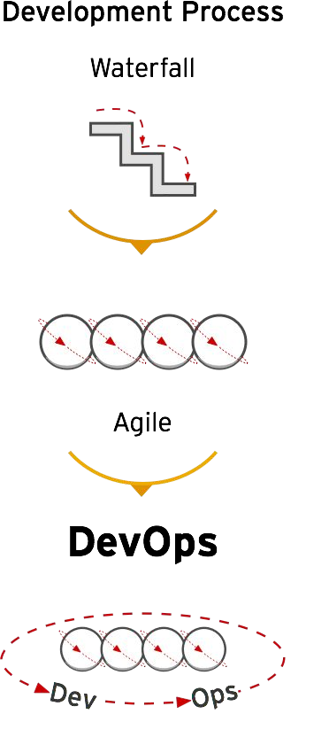
Development Process
Shift to more agile development and deployment processes
Increased collaboration between Development & Operations
Move from Continuous Integration to Continuous Deployment

Slide 5
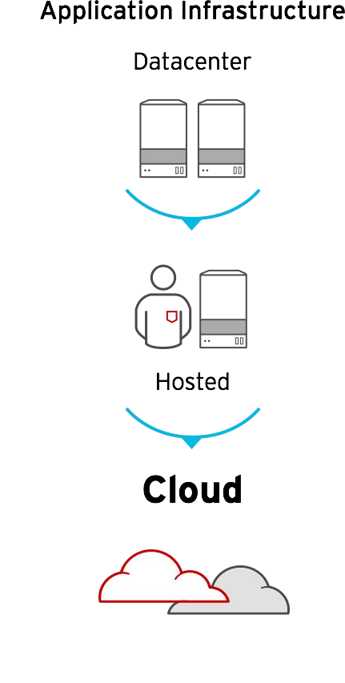
Platform Infrastructure
Shift from virtualization to scale-out cloud infrastructure
Rapid growth in public cloud usage for enterprises
Hybrid cloud deployments span private & multiple public clouds

Slide 6
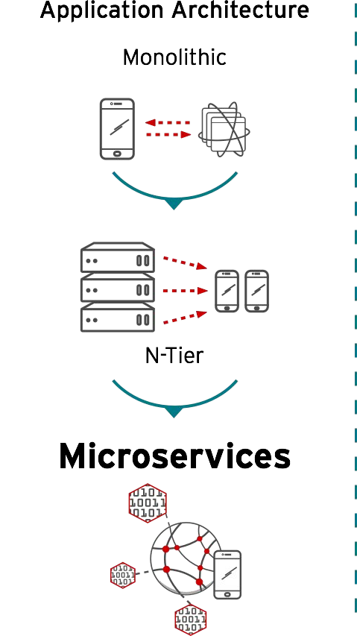
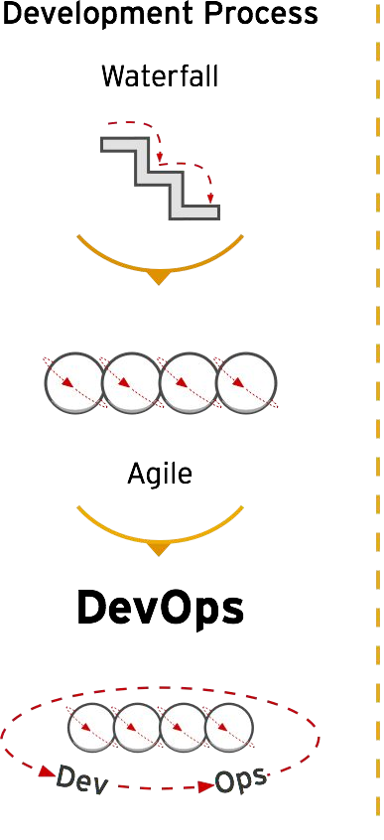
IT Must Evolve to Stay Ahead of These Trends

Slide 7
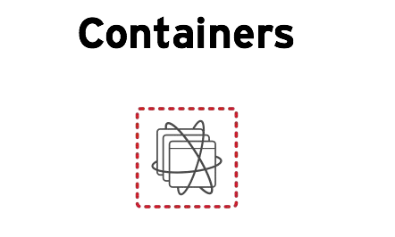
Containers - Transform Apps, Infrastructure & Process

Slide 8
LINUX CONTAINERS

Slide 9

WHAT ARE CONTAINERS?
It Depends Who You Ask
INFRASTRUCTURE
APPLICATIONS
Application processes on a shared kernel
Simpler, lighter, and denser than VMs
Portable across different environments
Package apps with all dependencies
Deploy to any environment in seconds
Easily accessed and shared

Slide 10
VIRTUAL MACHINES AND CONTAINERS
VIRTUAL MACHINES
CONTAINERS
VM
App | App | App | App
OS Dependencies
Kernel
Hypervisor
Hardware
Container
App OS deps
Container
App OS deps
Container
App OS deps
Container
App
OS deps
Container Host (Kernel)
Hardware
Virtual machines are isolated apps are not
containers are isolated so are the apps

Slide 11
VIRTUAL MACHINES AND CONTAINERS
Virtual Machine
Application OS dependencies Operating System
Container
Application
OS dependencies
Container Host
VM Isolation Complete OS Static Compute Static Memory
High Resource Usage
Container Isolation Shared Kernel Burstable Compute Burstable Memory Low Resource Usage

Slide 12
VIRTUAL MACHINES AND CONTAINERS
Virtual Machine Container
Application
Application
Dev
Clear ownership boundary between Dev and IT Ops drives DevOps adoption and fosters agility
IT Ops
(and Dev, sort of)
OS dependencies
OS dependencies
Operating System
Container Host
IT Ops
Infrastructure
Infrastructure
Optimized for stability Optimized for agility

Slide 13





APPLICATION PORTABILITY WITH VM
Virtual machines are NOT portable across hypervisor and do NOT provide portable packaging for applications
Guest VM
VM Type X
VM Type Y
VM Type Z
Application
Application
Application
Application
Application
OS dependencies
OS dependencies
OS dependencies
OS dependencies
OS dependencies
Operating System
Operating System
Operating System
Operating System
Operating System
LAPTOP
BARE METAL
VIRTUALIZATION
PRIVATE CLOUD
PUBLIC CLOUD

Slide 14
APPLICATION PORTABILITY WITH CONTAINERS
Linux Containers + RHEL = Guaranteed Portability Across Any Infrastructure
Container
Application OS dependencies
Container
Application OS dependencies
Container
Application OS dependencies
Container
Application OS dependencies
Container
Application OS dependencies
RHEL
RHEL
RHEL
RHEL
RHEL
Guest VM
Virtual Machine
Virtual Machine
Virtual Machine
LAPTOP
BARE METAL
VIRTUALIZATION
PRIVATE CLOUD
PUBLIC CLOUD

Slide 15


RAPID SECURITY PATCHING USING CONTAINER IMAGE LAYERING
Image Layer 3
Application Layer
Java Runtime Layer
OS Update Layer
Base RHEL
Image Layer 2
Image Layer 1
Base Image
Container Image Layers
Example Container Image

Slide 16
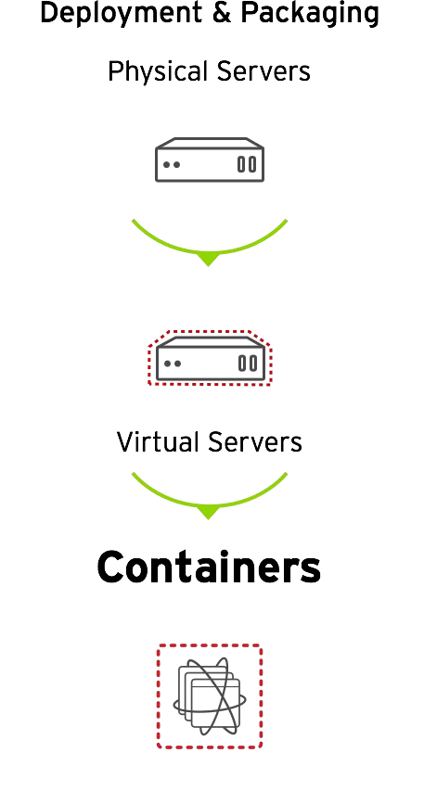
Containers - An Evolution in Application Deployment
Enable efficiency and automation for microservices, but also support traditional applications
Enable faster and more consistent deployments from Development to Production
Enable application portability across 4 infrastructure footprints: Physical, Virtual, Private & Public Cloud

Slide 17

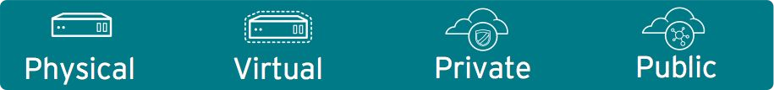
Red Hat Container Stack & Tools
Traditional, Stateful & Microservices-based Apps
Red Hat Registry
Red Hat Application Services (JBOSS)
Business Automation | Integration | Data | Web & Mobile | 3rd party frameworks
CONTAINER | CONTAINER | CONTAINER | CONTAINER | CONTAINER
PaaS
CloudForms
Red Hat OpenShift Container Platform (incl. CloudForms)
LIFECYCLE AUTOMATION
(Self-service, CI/CD, Image Stream)
CONTAINER MANAGEMENT
(Monitoring, Capacity, Policies)
Ansible
CaaS
Storage
CONTAINER INFRASTRUCTURE
(Orchestration & Scheduling, Storage, Registry, Security, Networking)
Satellite
Red Hat Enterprise Linux & Atomic Host
ENTERPRISE-GRADE CONTAINER OS
Developer Studio
IaaS
CDK

Slide 18
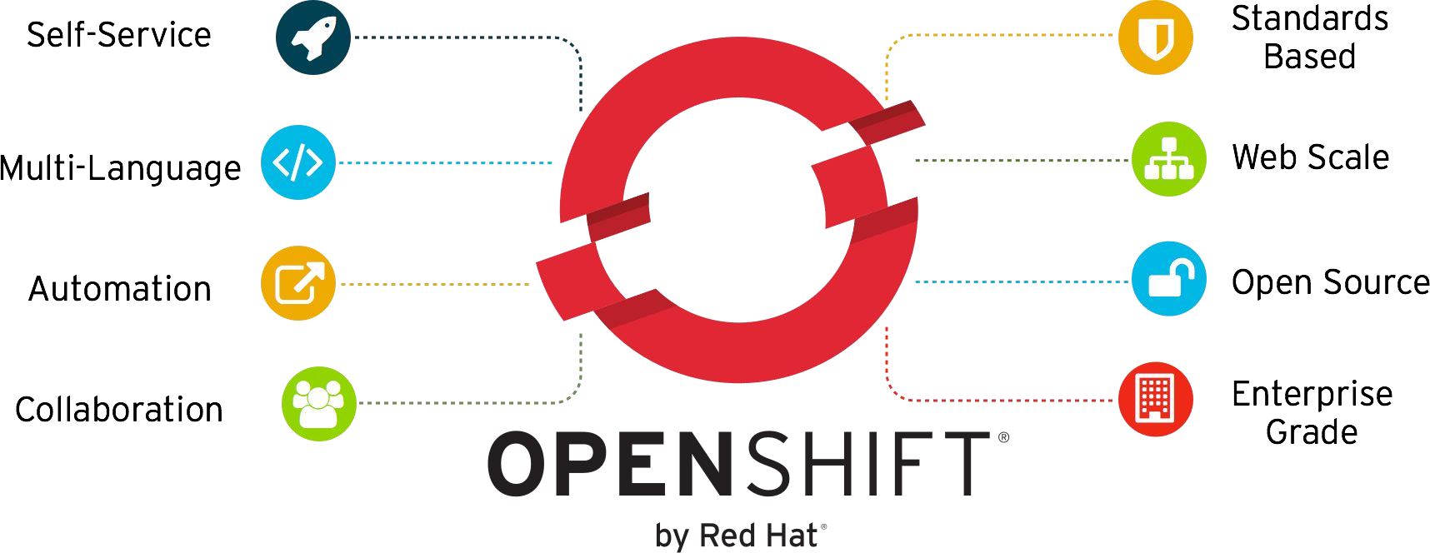
OpenShift Enables Dev and Ops

Slide 19
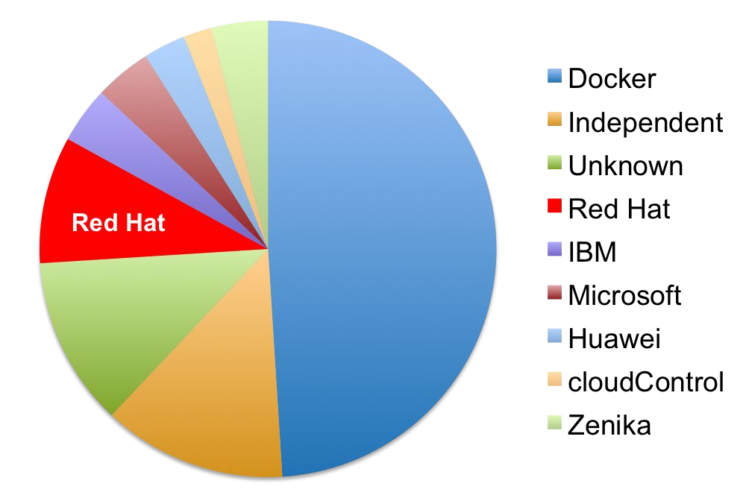
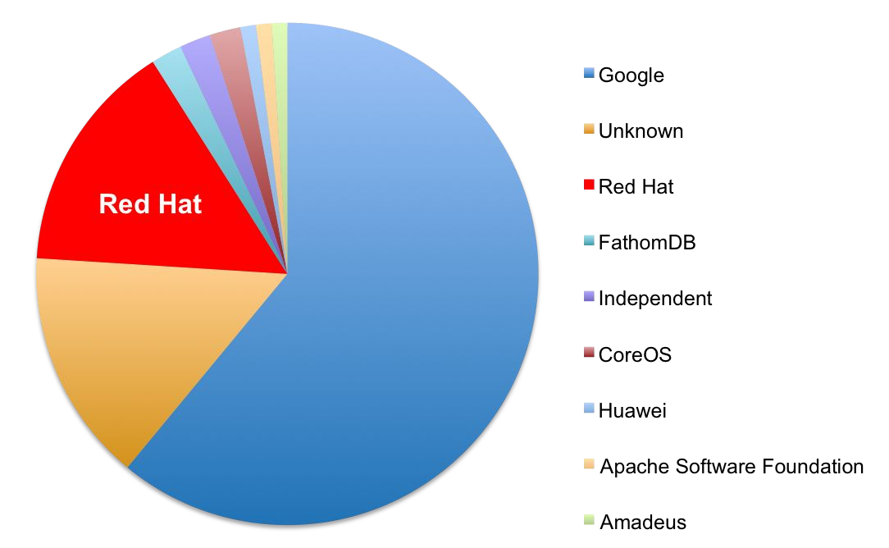
Built on Open Container Standards
Red Hat Driving These in the Community
docker
kubernetes

Slide 20
Thank You

